Slide 1
Code Development and Review with Git
Mark Yan & Debasish Das

Slide 2
Step 1
Local
Remote
dev
dev
2
At the start point, we assume we have a master and dev branch in the remote side. We will not discuss master branch here.
Clone remote dev branch to local.
git clone “repo url”
git checkout dev

Slide 3
Step 2
Local
Remote
dev
feature
dev
feature
Create a new local feature branch.
git checkout -b feature
Push local feature branch to remote side.
git push origin feature:feature
1
2

Slide 4
Step 3
Local
Remote
dev
feature
dev
feature
Code Development on local branch feature.
Test your application.
commit change to local feature branch.
git add “commit file name”
git commit -m “comment”
git pull origin feature
(if someone changed remote feature branch, we should merge the change first)
git push --set-upstream origin feature
3
4
5
Note: we recommend that this step is done for every small progress to publish to/merge from remote feature branch.

Slide 5
Step 4
Local
Remote
dev
feature
dev
feature
Run “git status” and make sure you are on feature branch.
Run “git pull origin dev” to merge latest remote dev branch into local feature branch.
Resolve merge conflicts if any.
Test your application.
Commit and push to remote feature branch.
git commit -m “comment”
git push
2
5
Note: we recommend that this step is done in regular base to incorporate latest change in dev branch before pull request.

Slide 6
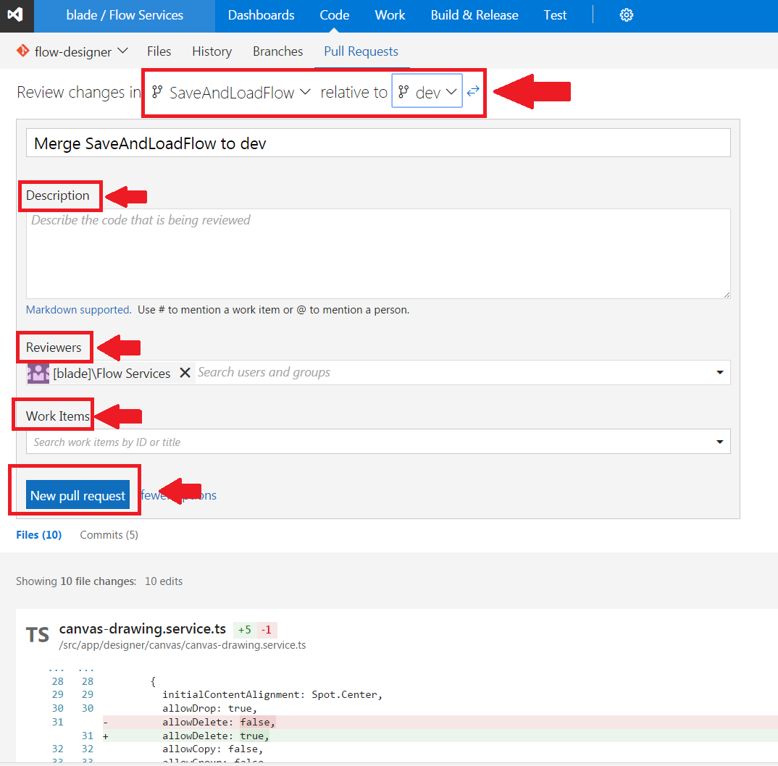
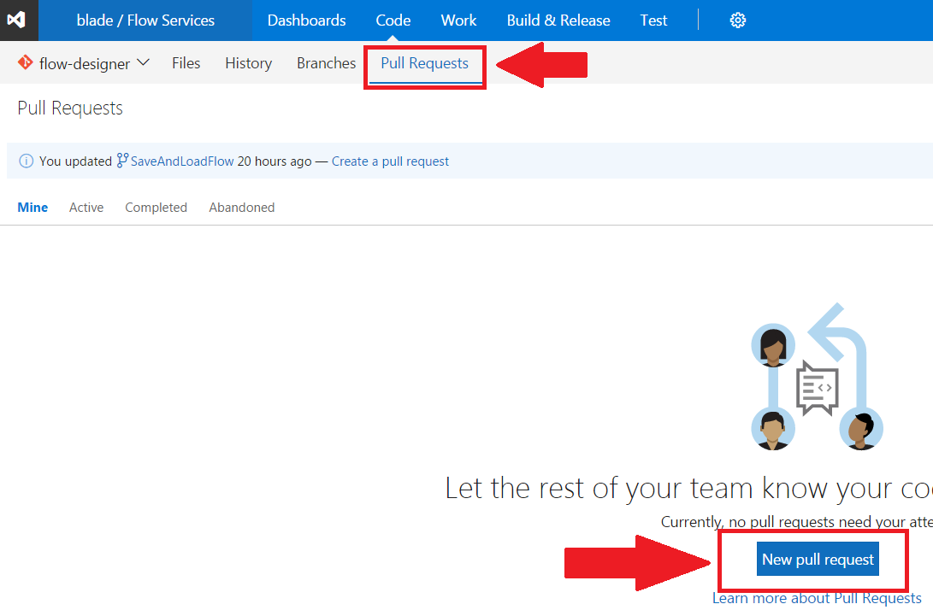
Step 5
Create Pull request for code review

Slide 7
Step 6
Local
Remote
dev
feature
dev
feature
Code reviewer comment/suggest rework/approve the pull request.
Reviewer reject pull request if there is merge conflict.
Merge remote feature branch into remote dev branch
Do not delete remote feature branch.
3

Slide 8
Step 7
Local
Remote
dev
feature
dev
feature
Move back to dev branch
git checkout dev
Delete local feature branch
git branch -d feature
Resync with remote dev branch
git pull
Start next feature development
3

